Slide 1
COMPLETE DIGITAL COMMUNICATION SYSTEM USING MATLAB
CHAITRA GURUVELLI-BT21ECE130
ANUSHKA CHINTAWAR-BT21ECE096
VANASHREE PARATE-BT21ECE084
ANJALIKA AGARWAL-BT21ECE095

Slide 2
OVERVIEW
Each block is built using the following techniques.
Source Coding: Huffman encoding
Channel Coding: Convolutional encoding
Modulation: Amplitude Shift Keying (ASK), and Phase Shift Keying (PSK) modulation
Channel: Additive White Gaussian Noise Channel
Demodulation: ASK and PSK demodulation
Channel Decoding: Viterbi decoding
Source Decoding: Huffman decoding

Slide 3
OBJECTIVE
This project is the simulation of a complete digital communication system. A digital communication system consists of multiple blocks and each block is implemented here as a MATLAB function and the 'main_code.m' file combines them all to build the complete system. The system reads text file 'source_data.txt' from the Data folder and process the text data accordingly and writes the received text into another text file named 'received.txt' again in the Data folder. The block diagram below shows all the blocks of the system in a sequential manner.

Slide 4
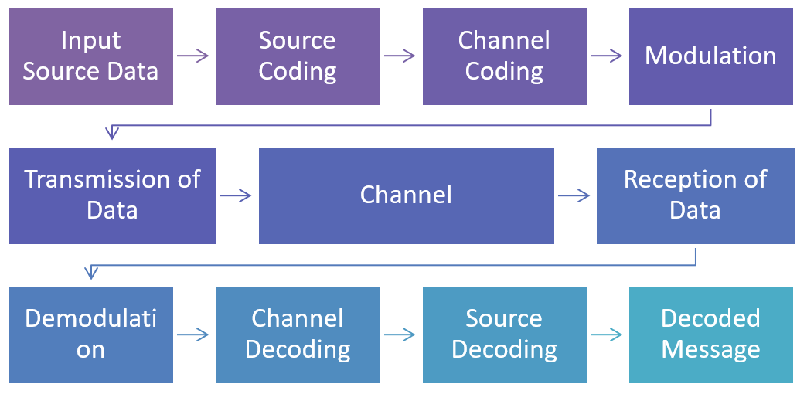
BLOCK DIAGRAM

Slide 5
SOURCE CODING
HUFFMAN ENCODING:
Huffman encoding is a widely used algorithm for lossless data compression. It assigns variable-length codes to input symbols, where the length of each code is based on the probability of the corresponding symbol. Shorter codes are assigned to more probable symbols to achieve efficient compression
The code assumes the input probabilities are given and it constructs the Huffman codes based on these probabilities. The resulting code_word cell array contains Huffman codes for each symbol, which can be used for encoding and decoding data.

Slide 6
CHANNEL CODING
CONVOLUTIONAL ENCODING:
Convolutional codes are a type of error-correcting codes used in digital communications. In this function, a simple matrix multiplication (convolution) and modulo-2 operation (remainder operation) are performed to generate the coded bit stream. The effectiveness of the convolutional code depends on the choice of the generator matrix G. The generator matrix determines the code rate, constraint length, and the error-correcting capabilities of the convolutional code.

Slide 7
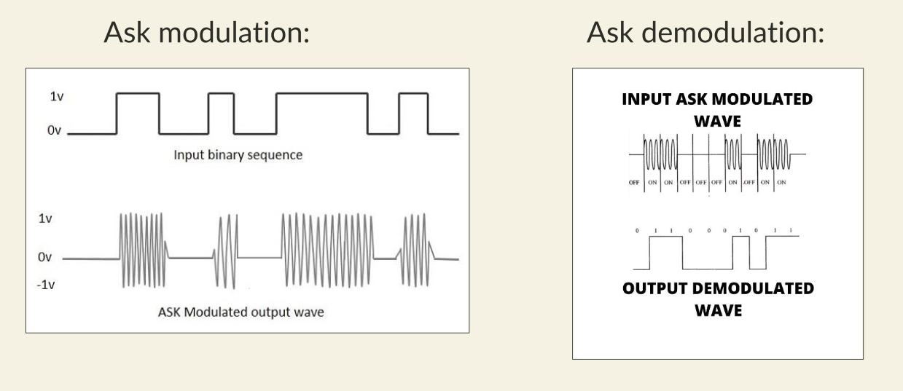
MODULATION AND DEMODULATION:

Slide 8
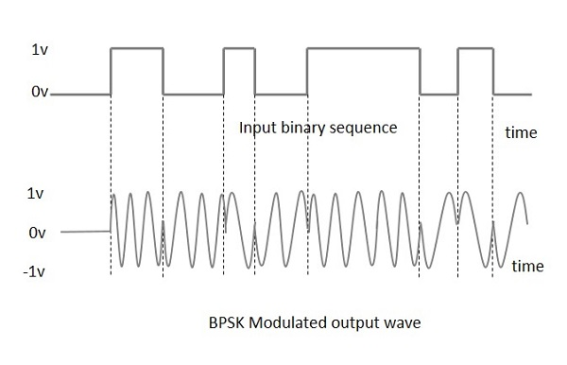
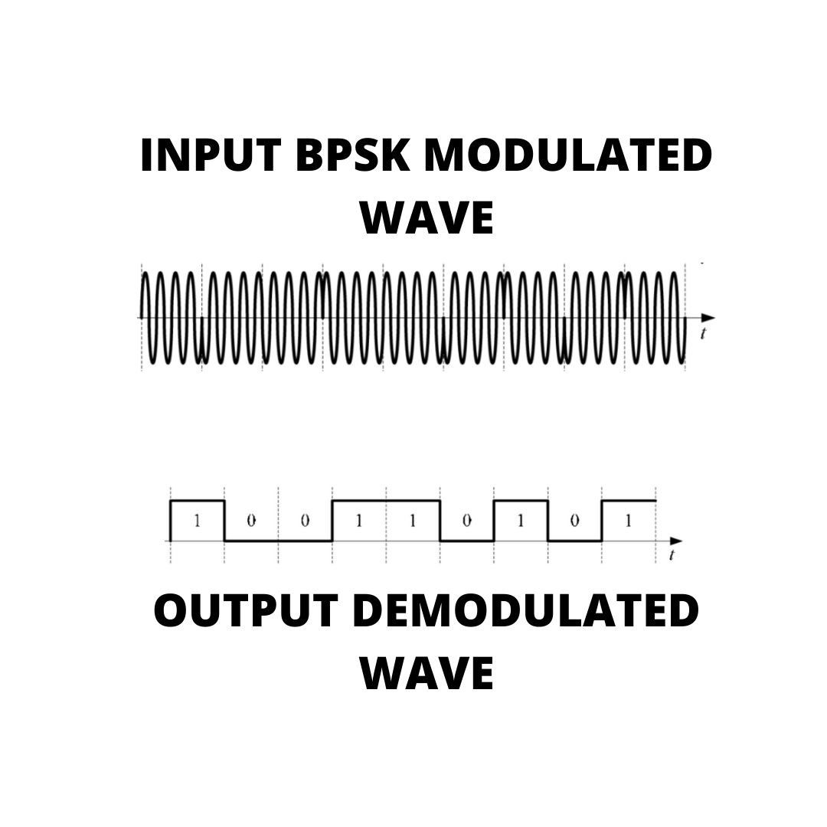
BLOCK DIAGRAM
BPSK modulation: BPSK demodulation:

Slide 9
CHANNEL DECODING
VETERBI DECODING:
Viterbi decoding, a widely used technique in digital communication and error correction. Viterbi decoding is particularly effective for decoding convolutional codes. This function is a critical component in digital communication systems, helping correct errors and recover transmitted data accurately. The efficiency of the Viterbi algorithm lies in its ability to find the most likely sequence of transmitted bits, even in the presence of noise and channel distortions.

Slide 10
SOURCE DECODING
HUFFMAN DECODING:
Huffman codes are variable-length codes, meaning different symbols are represented by codes of varying lengths, with more frequent symbols assigned shorter codes. During decoding, the encoded bit stream is analyzed based on these codes, reconstructing the original symbols. Huffman decoding is widely used in applications like file compression, network protocols, and multimedia compression, enabling efficient storage and transmission of data while preserving the integrity of the information.

Slide 11
The simulation is performed using the following properties.
MODULATION TYPES : ASK, BPSK
SAMPLES PER BIT : 40
BITRATE : 1000
CARRIER FREQUENCY : 1000Hz
CARRIER AMPLITUDE : 1V
SNR : 10 dB
GENERATOR MATRIX FOR CHANNEL CODE : [111;101]
NUMBER OF BIT SHIFT IN THE REGISTER : 1

Slide 12
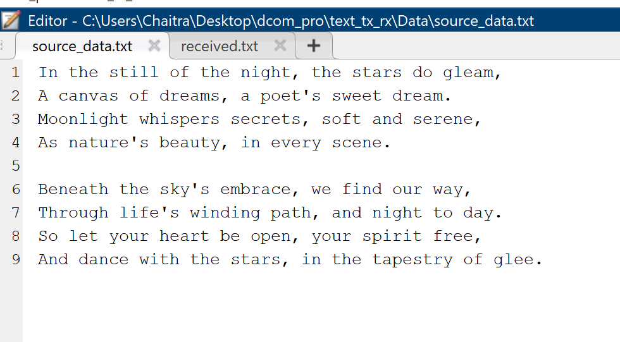
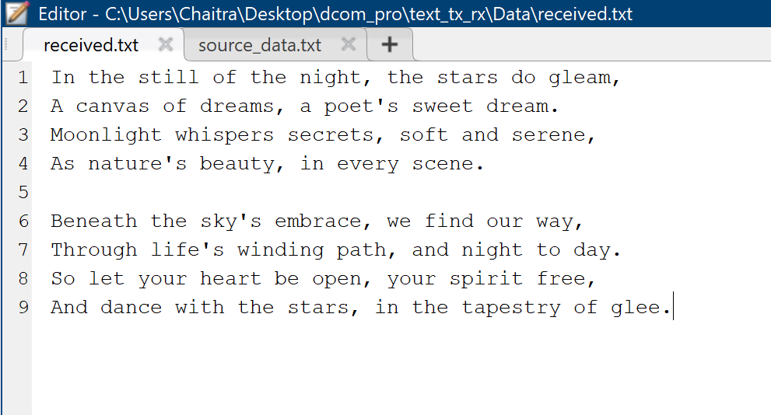
RESULTS

Slide 13
REFERENCES
"Digital Communications" by John G. Proakis and Masoud Salehi
"Digital Communication: Theory and Lab Experiments Using MATLAB" by Mathini Sellathurai and
Devasena Desai:
MATLAB and Simulink for Digital Communication
MATLAB Documentation

